Slide 1

Introduction to PHP 8
Temuri Takalandze
@ABGEO

Slide 2
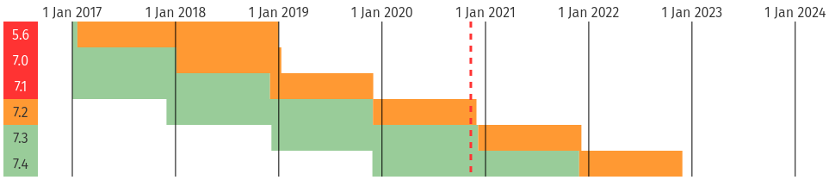
Timeline
https://www.jetbrains.com/lp/php-25/

Slide 3
About PHP 8
General
About types
What’s new in OOP?
New built-in functions
Breaking changes

Slide 4
General

Slide 5

JIT
https://wiki.php.net/rfc/jit
JIT - just in time - Compiler
“PHP JIT is implemented as an almost independent part of OPcache. It may be enabled/disabled at PHP compile time and at run-time. When enabled, native code of PHP files is stored in an additional region of the OPcache shared memory and op_array→opcodes[].handler(s) keep pointers to the entry points of JIT-ed code.”

Slide 6
How PHP works
Tokenizing: First, the interpreter reads the PHP code and builds a set of tokens.
Parsing: The interpreter checks if the script matches the syntax rules and uses tokens to build an AST.
Compilation: The interpreter traverses the tree and translates AST nodes into low-level Zend opcodes.
Interpretation: Opcodes are interpreted and run on the Zend VM.

Slide 7
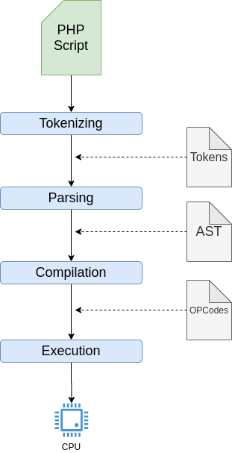
How PHP works

Slide 8
OPcache
“OPcache improves PHP performance by storing precompiled script bytecode in shared memory, thereby removing the need for PHP to load and parse scripts on each request.”

Slide 9
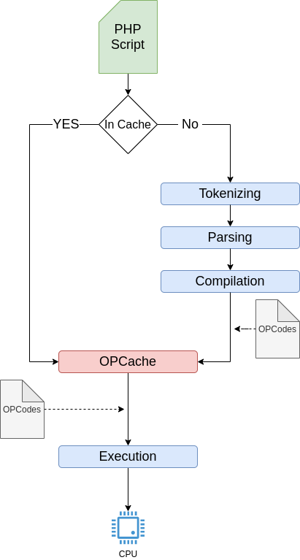
OPcache

Slide 10
Preloading
Allows you to tell PHP FPM to parse your codebase, transform it into Opcodes and cache them even before you execute anything.

Slide 11
JIT Compiler
JIT “doesn’t introduce any additional IR (Intermediate Representation) form”.
JIT uses DynASM (Dynamic Assembler for code generation engines) to generate native code directly from PHP byte-code.
JIT translates the hot parts of the intermediate code into machine code. Bypassing compilation, it’d be able to bring considerable improvements in performance and memory usage.
With JIT enabled, the code wouldn’t be run by the Zend VM, but by the CPU itself, and this would improve speed in calculation.

Slide 12
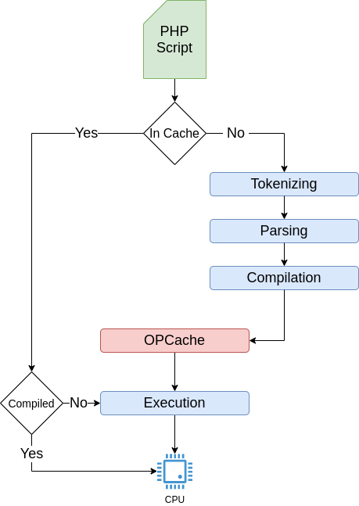
JIT Compiler

Slide 13
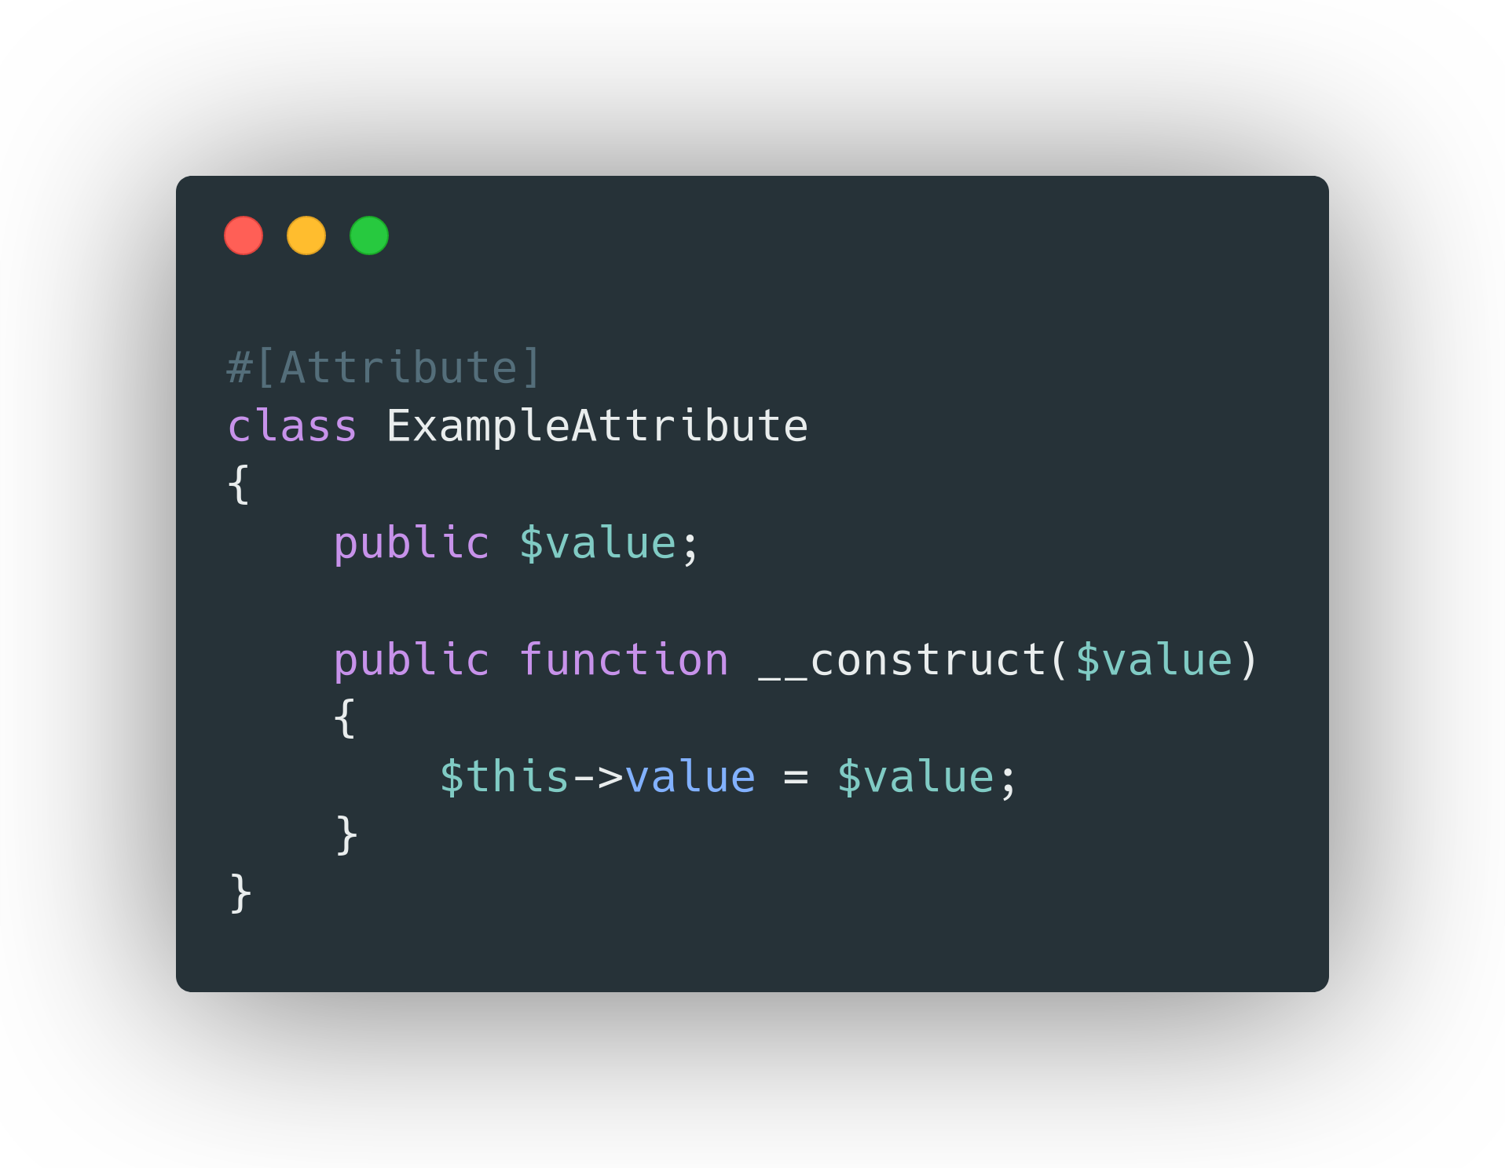
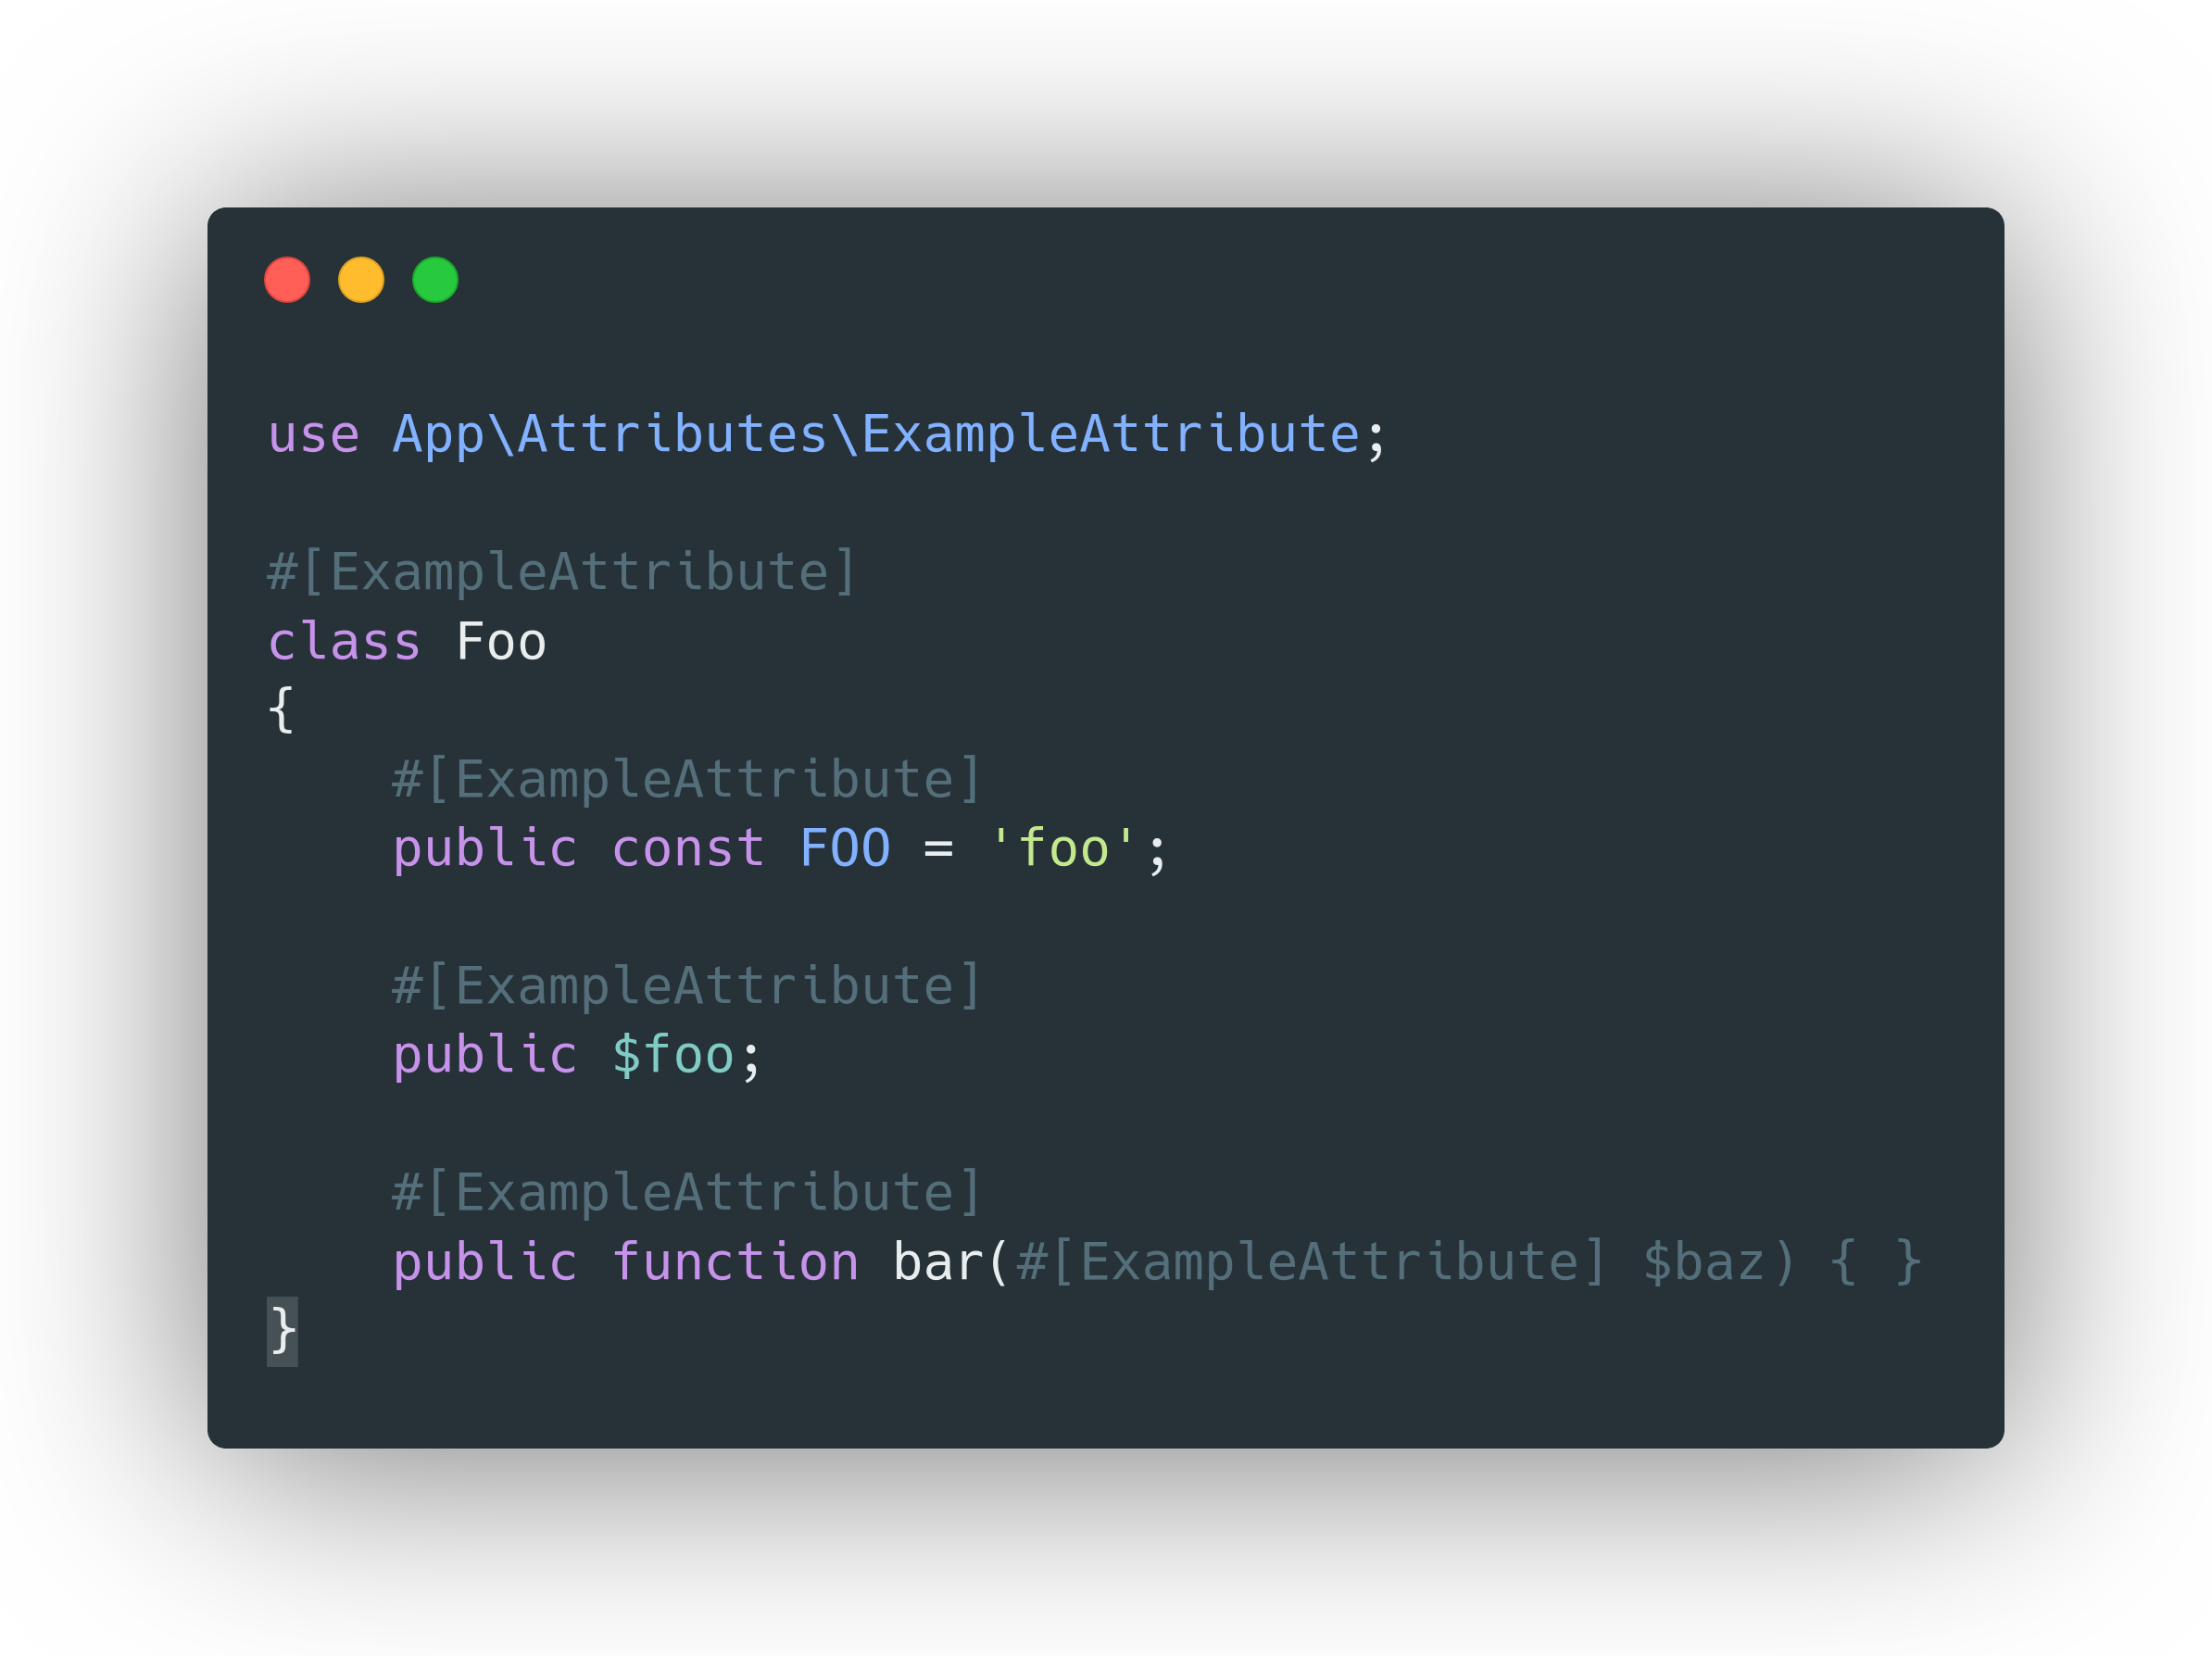
Attributes
https://wiki.php.net/rfc/attributes_v2

Slide 14
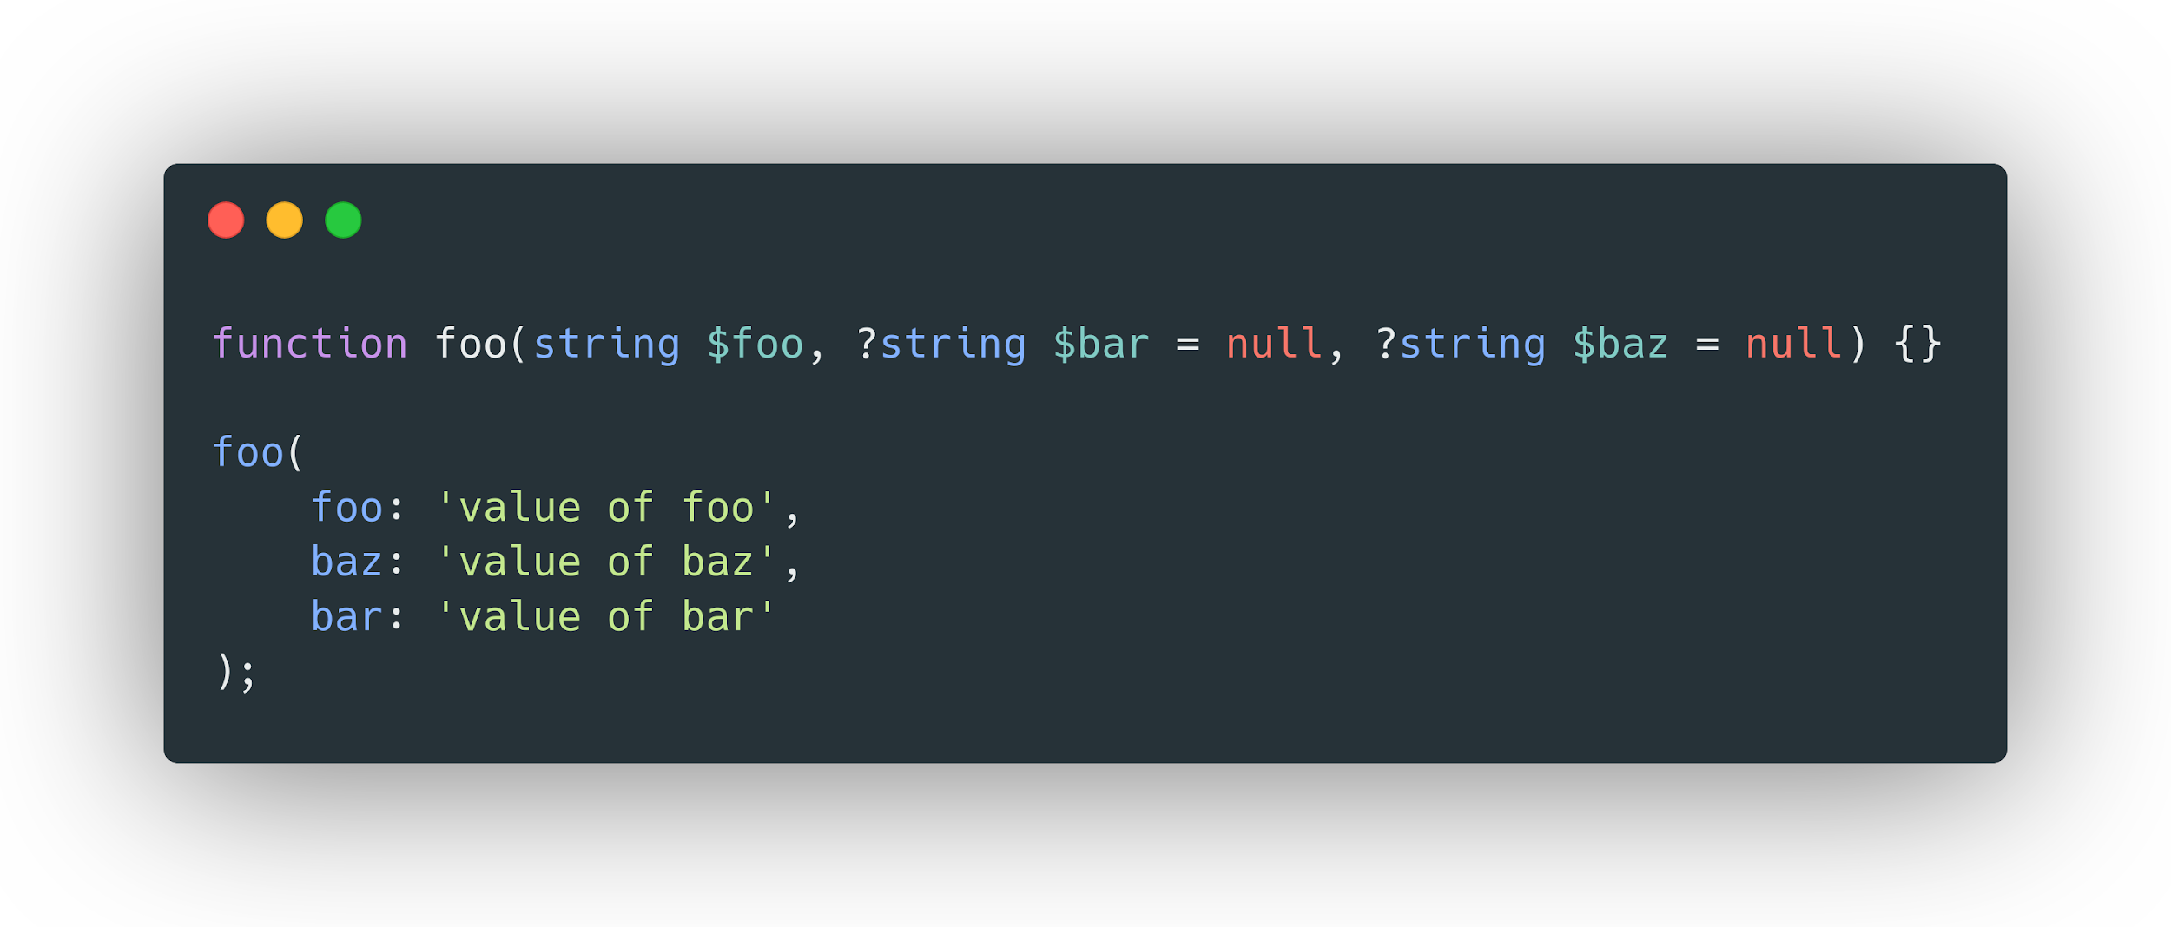
Named arguments
https://wiki.php.net/rfc/named_params

Slide 15
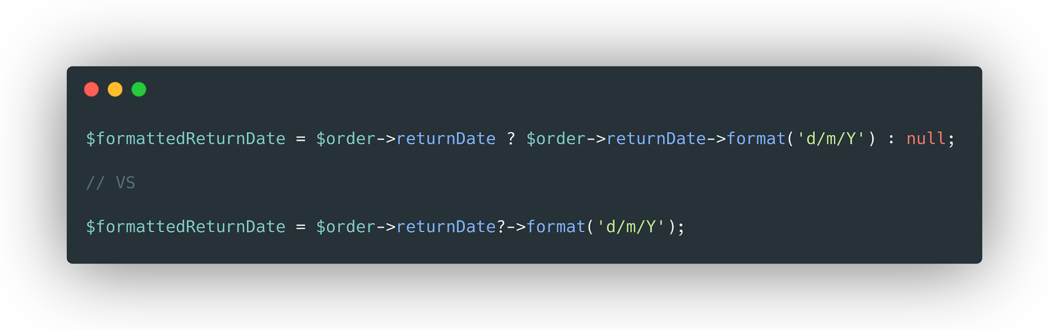
The nullsafe operator
https://wiki.php.net/rfc/nullsafe_operator

Slide 16
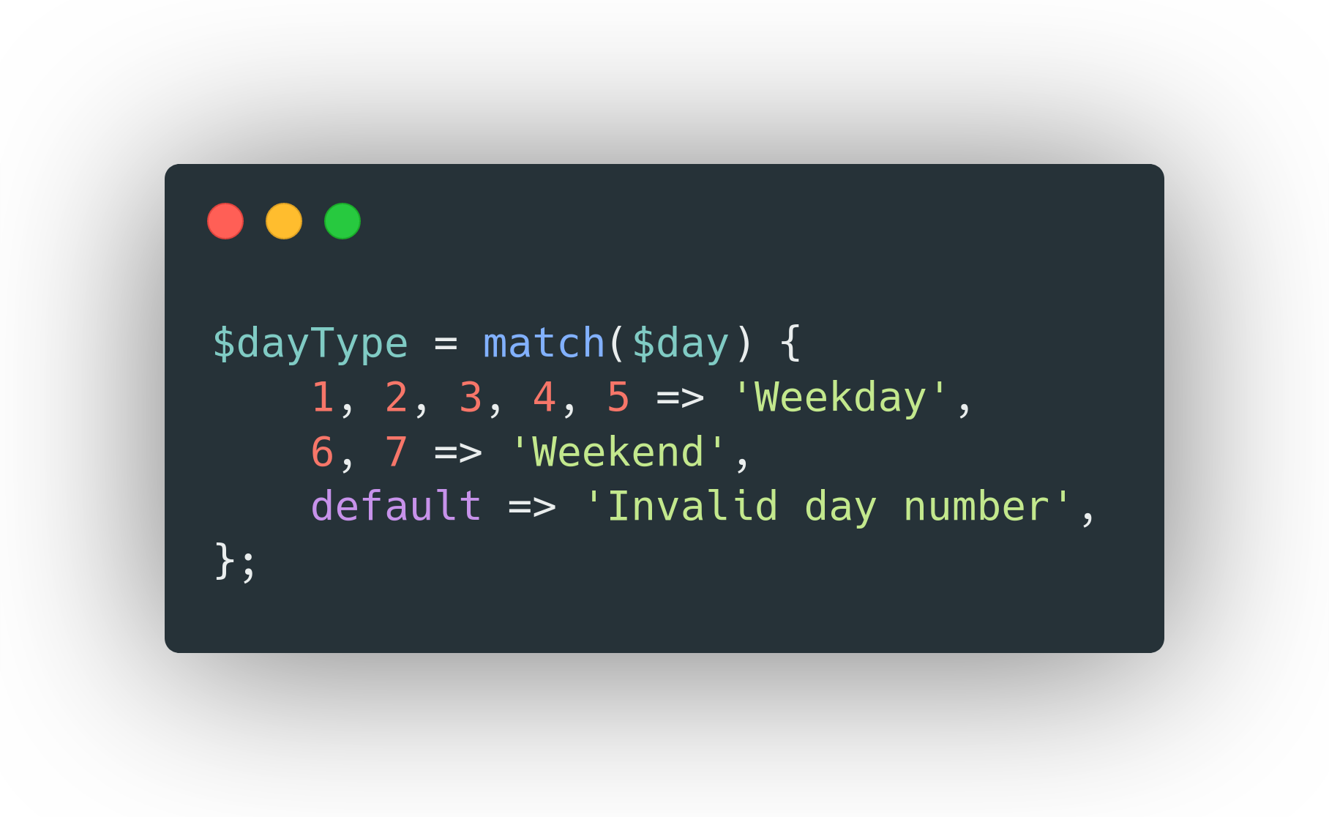
Match expression
https://wiki.php.net/rfc/match_expression_v2

Slide 17
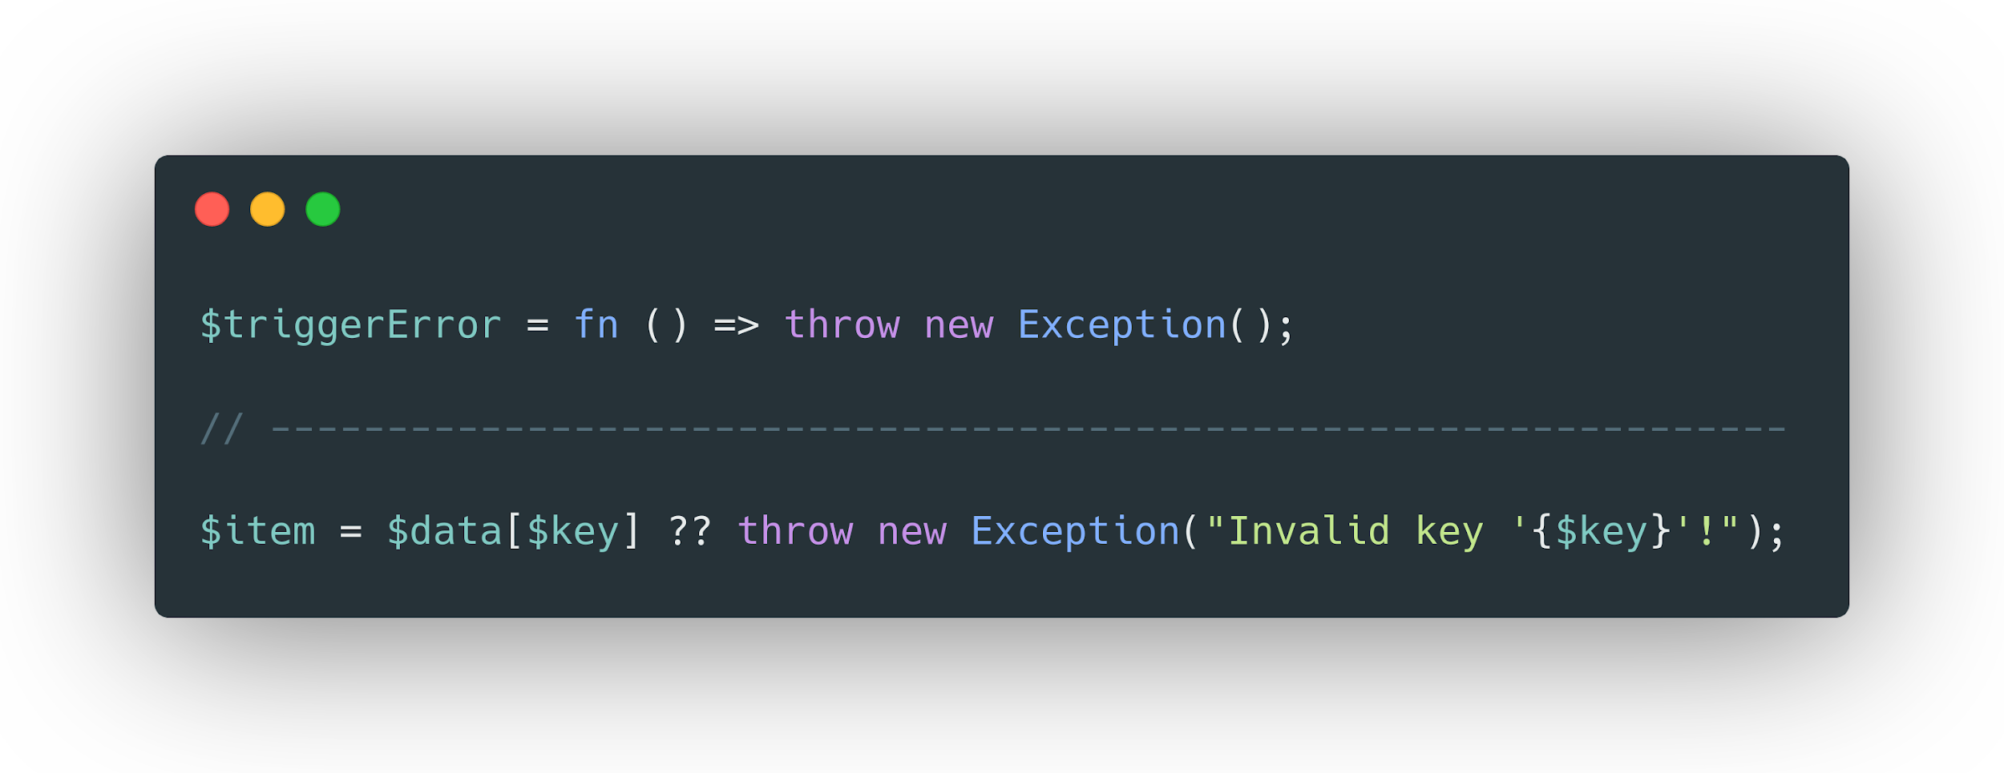
Throw expression
https://wiki.php.net/rfc/throw_expression

Slide 18
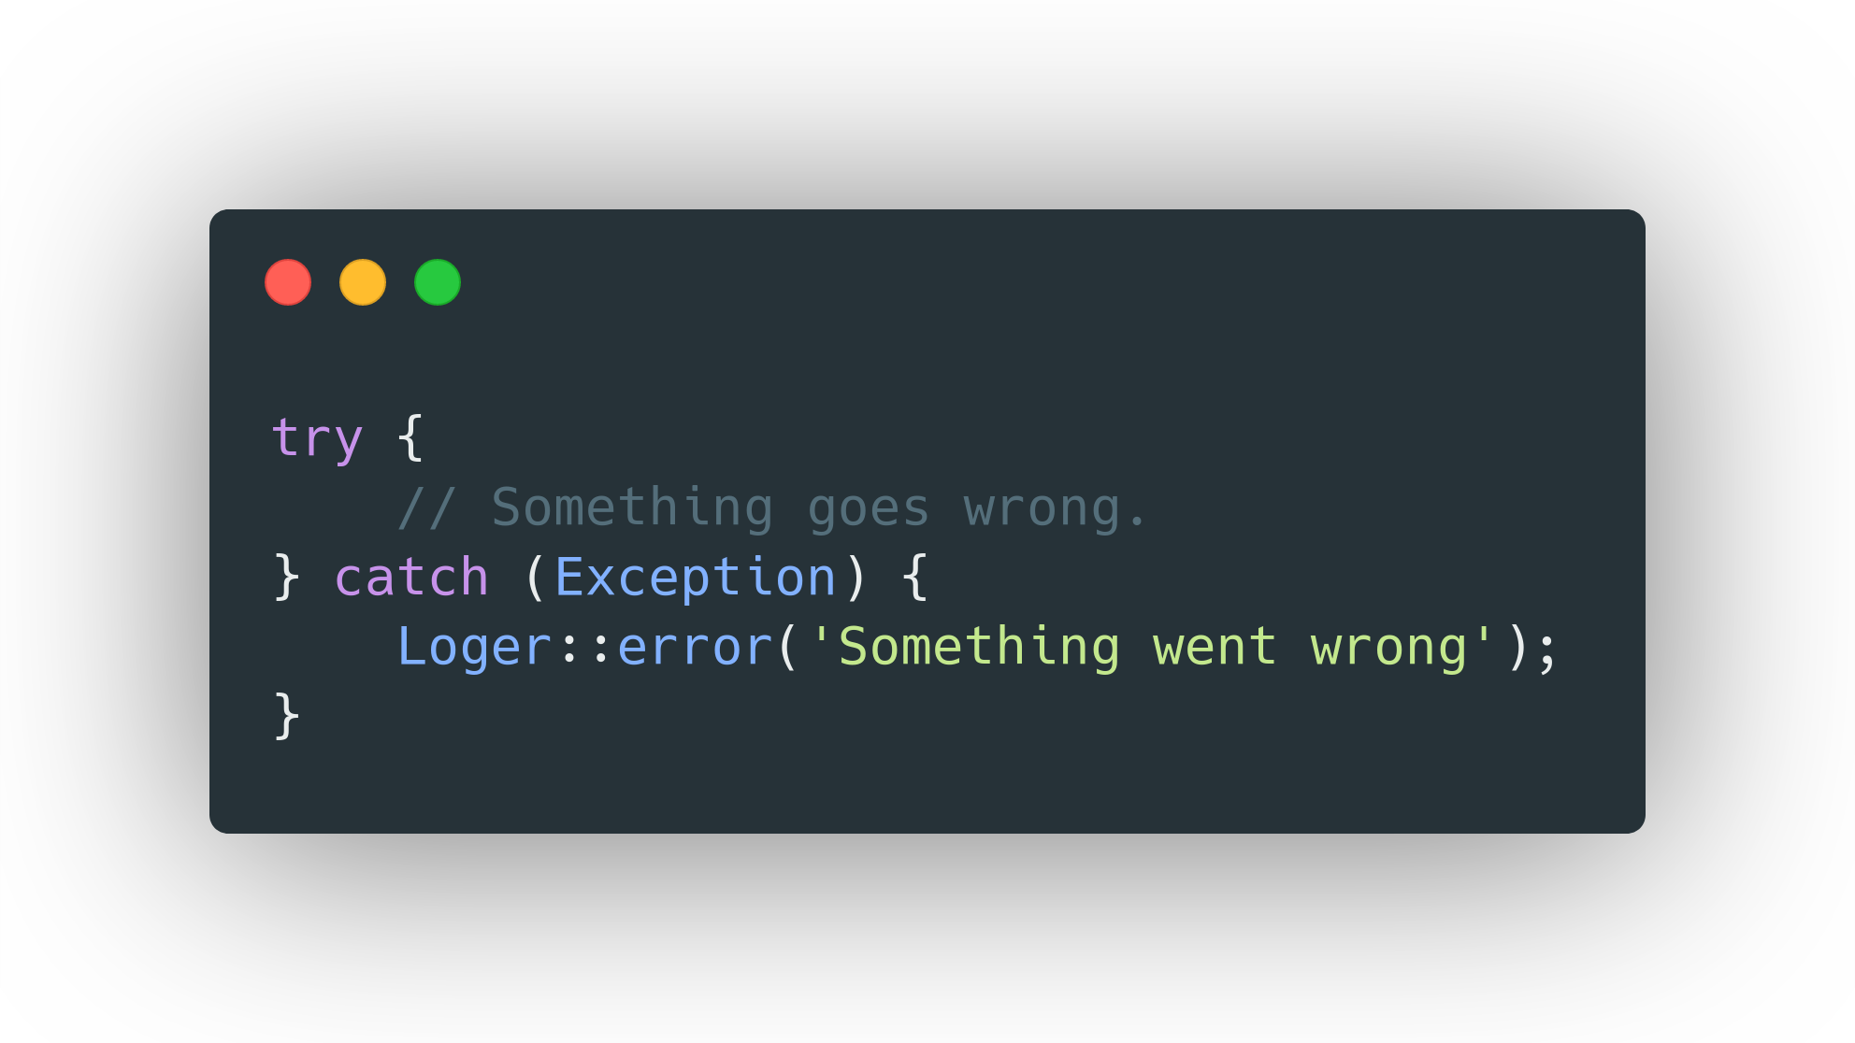
Non-capturing catches
https://wiki.php.net/rfc/non-capturing_catches

Slide 19
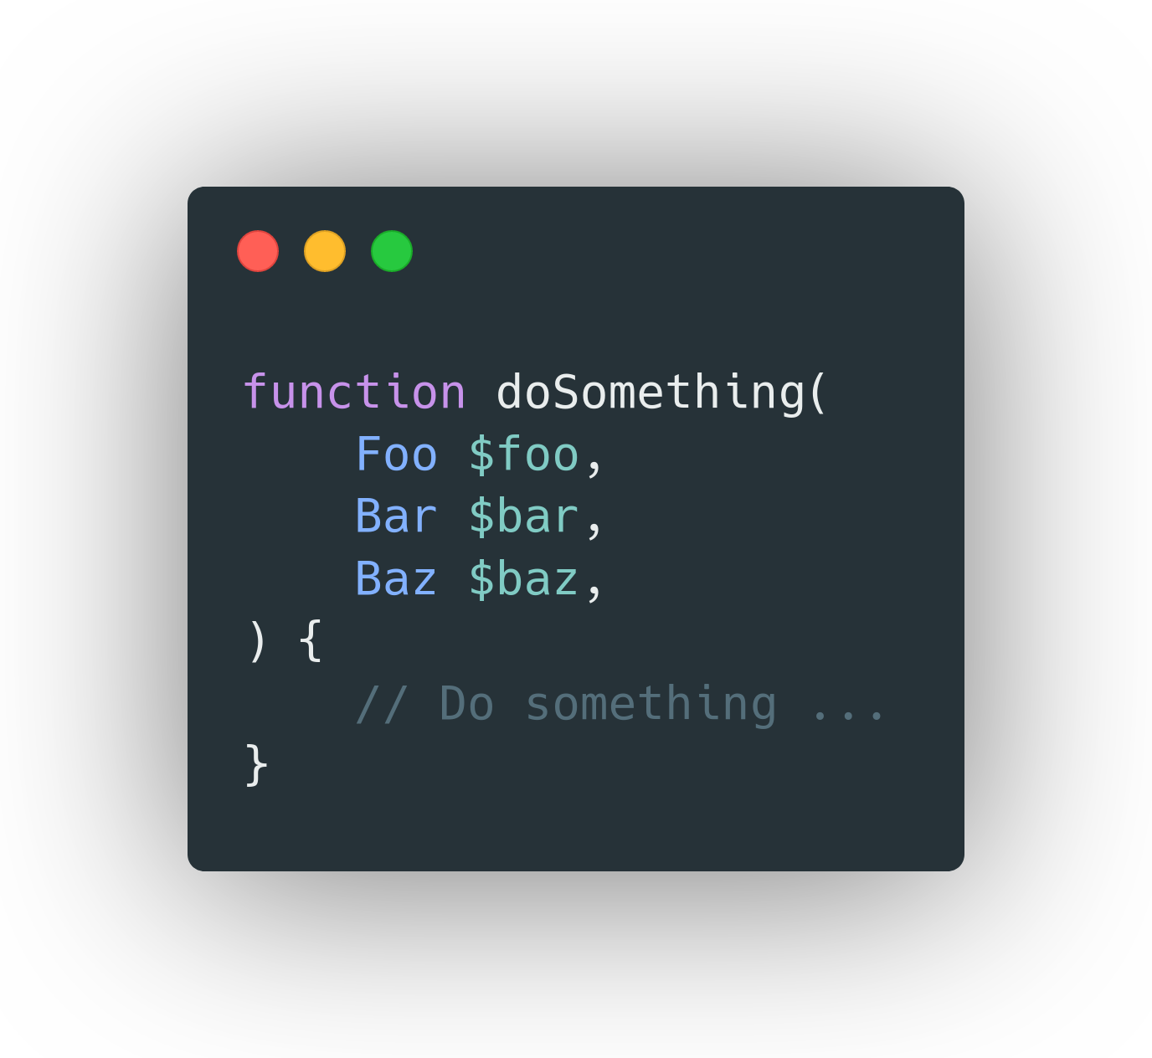
Trailing comma in parameter lists
https://wiki.php.net/rfc/trailing_comma_in_parameter_list

Slide 20
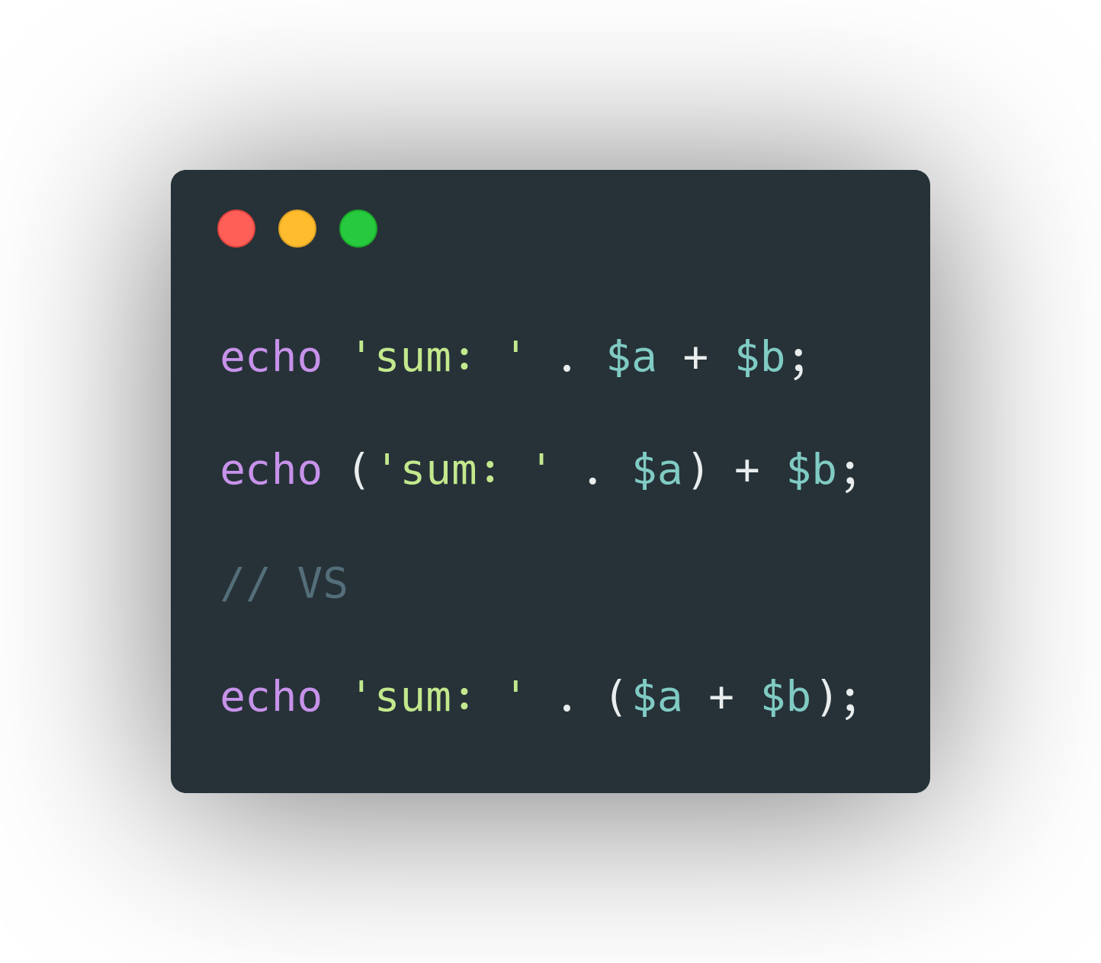
Concatenation precedence
https://wiki.php.net/rfc/concatenation_precedence

Slide 21
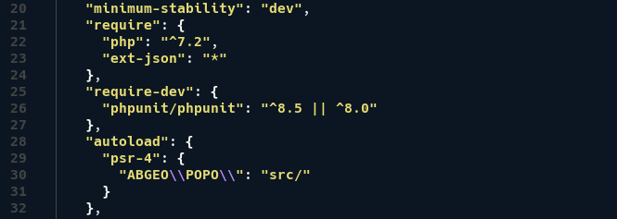
ext-json always available
https://wiki.php.net/rfc/always_enable_json

Slide 22
About types

Slide 23
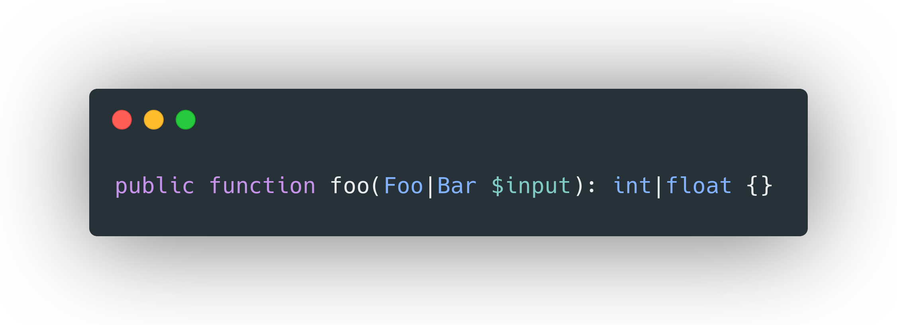
Union types
https://wiki.php.net/rfc/union_types_v2

Slide 24
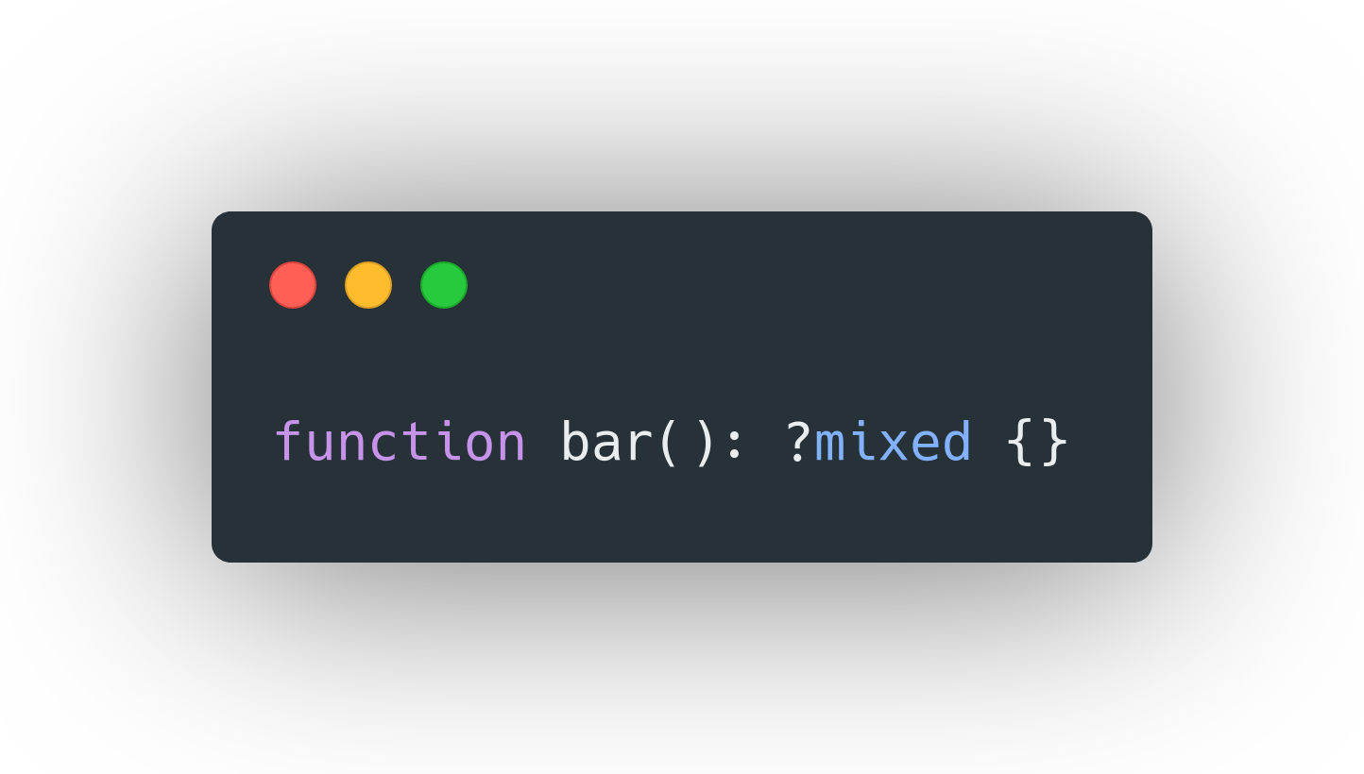
Mixed type
https://wiki.php.net/rfc/mixed_type_v2
array
bool
callable
int
float
null
object
resource
string
The mixed type can also be used as a parameter or property type, not just as a return type.
Since mixed already includes null, it's not allowed to make it nullable. The following will trigger an error:

Slide 25
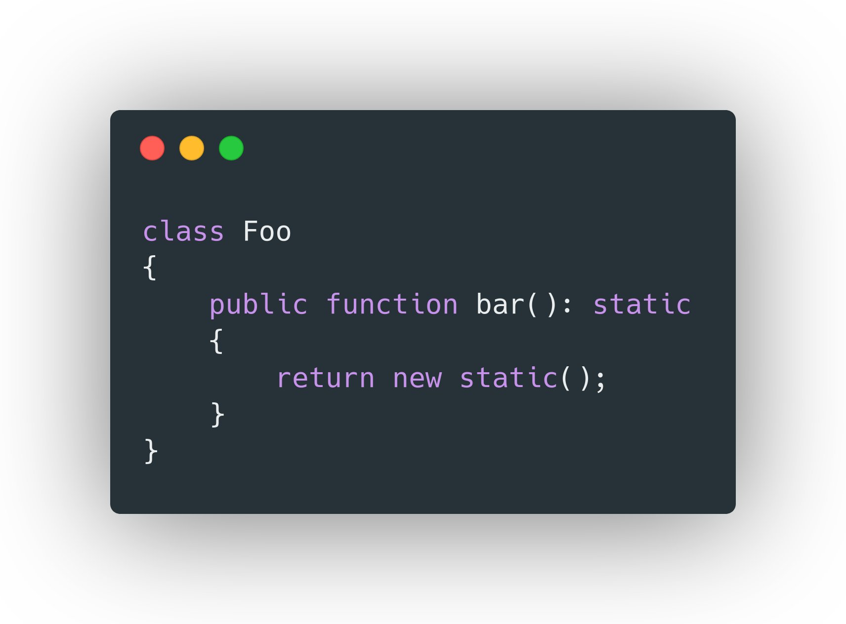
Static return type
https://wiki.php.net/rfc/static_return_type

Slide 26
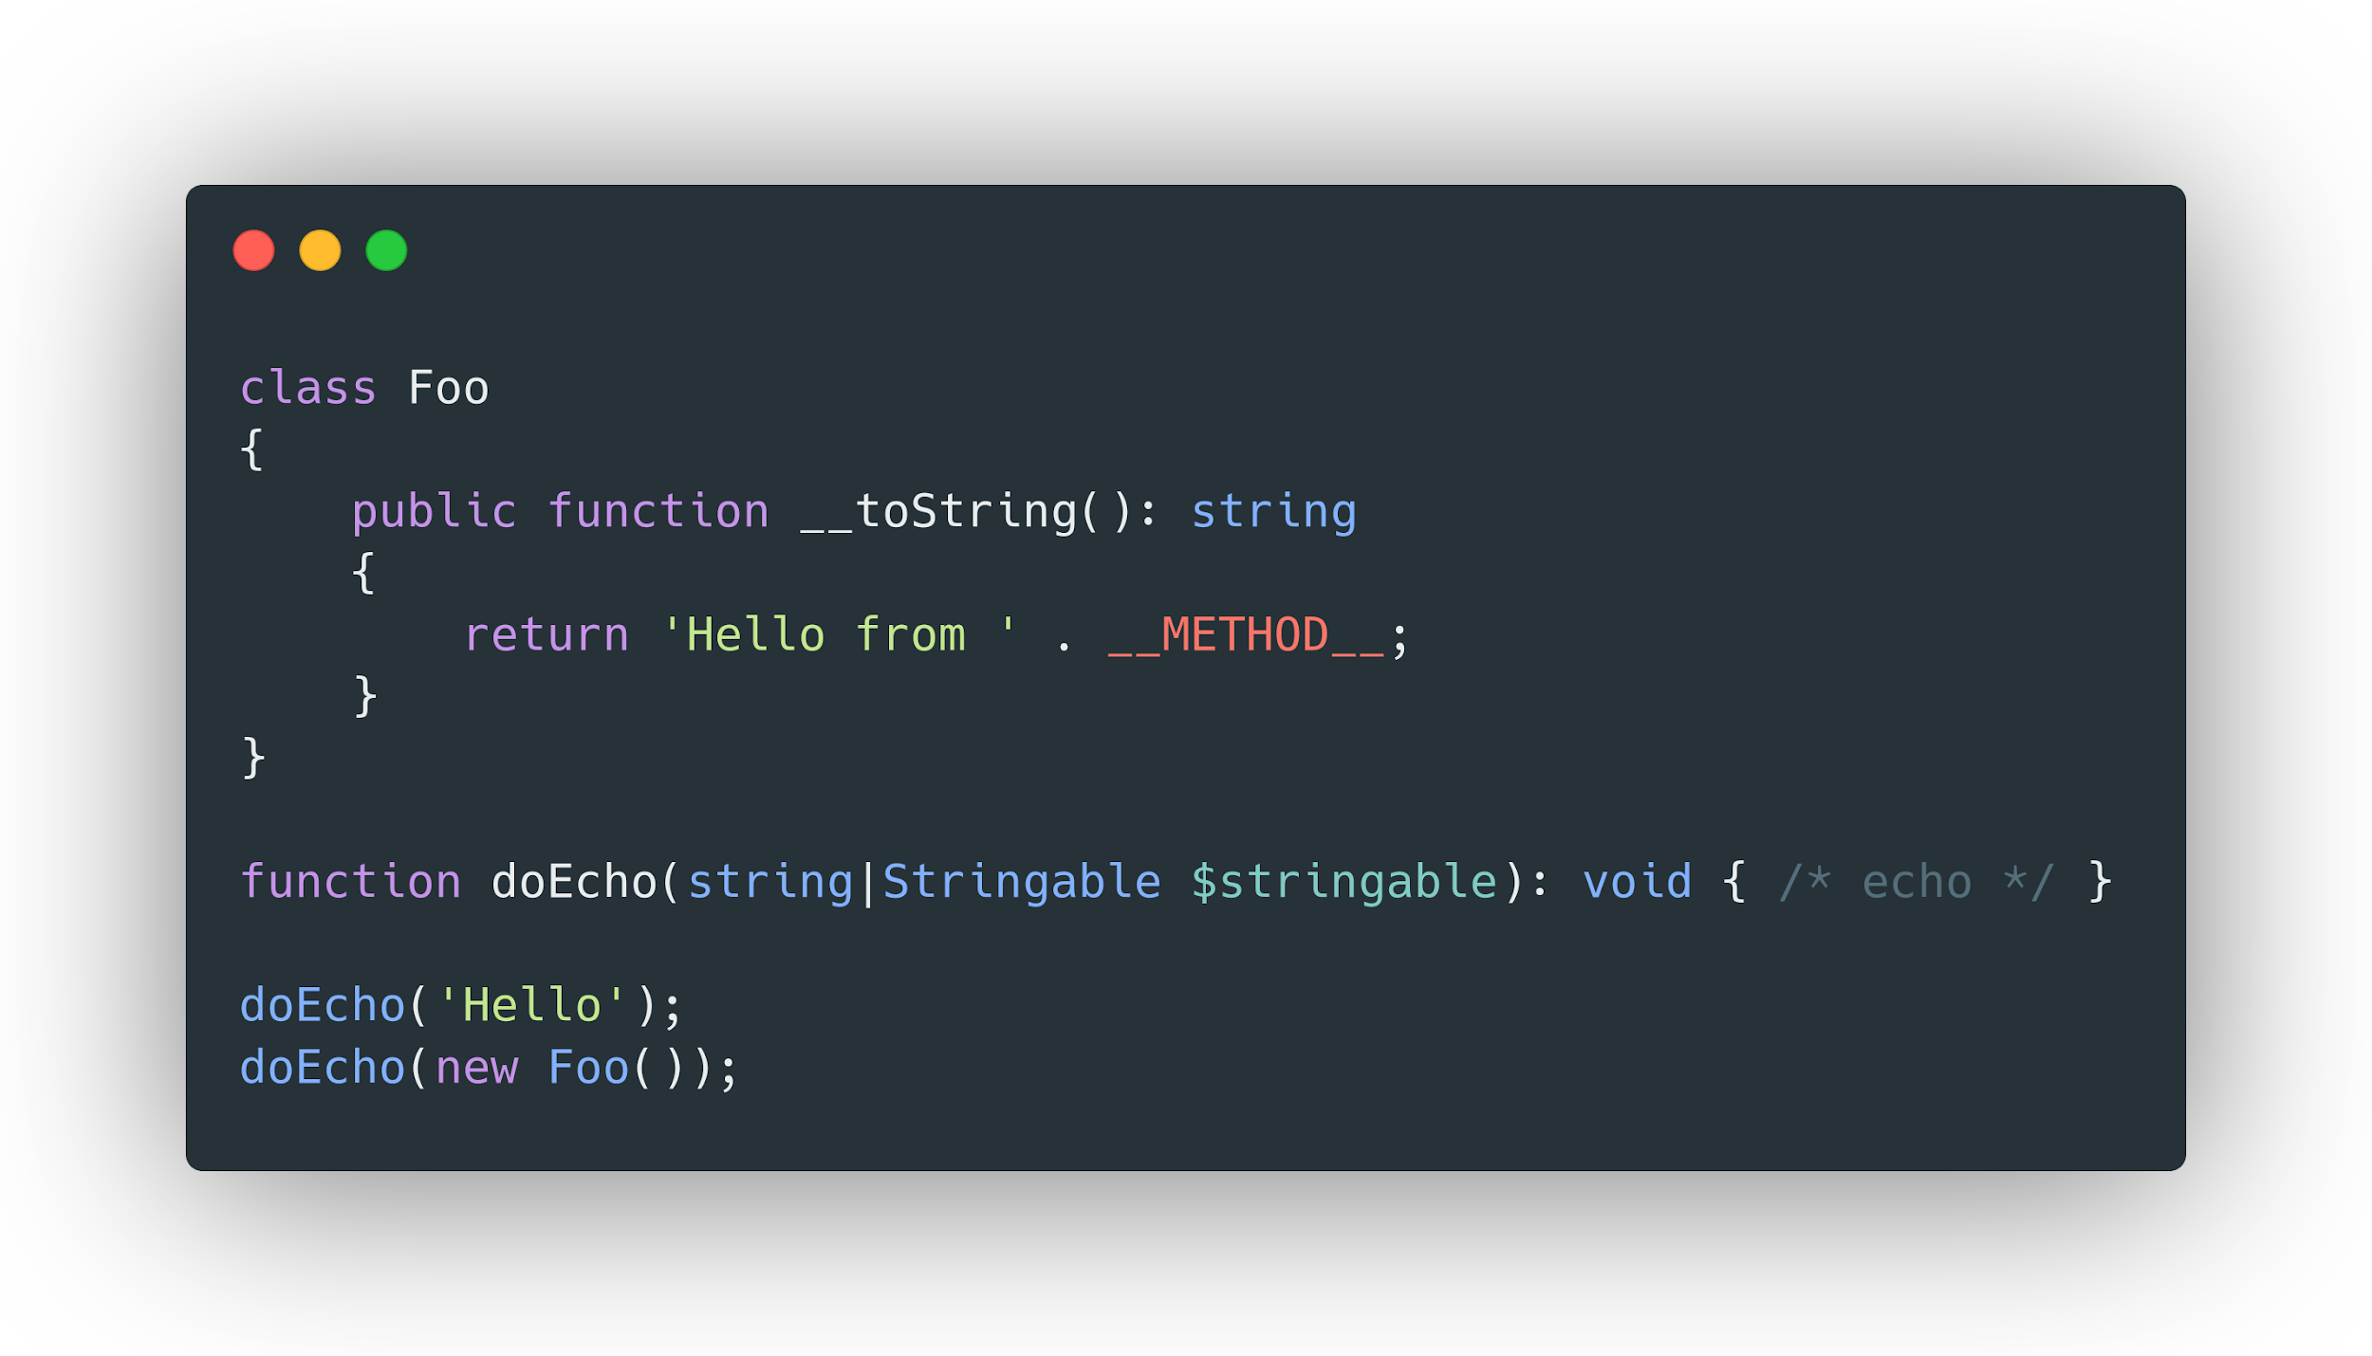
New Stringable interface
https://wiki.php.net/rfc/stringable

Slide 27
What’s new in OOP?

Slide 28
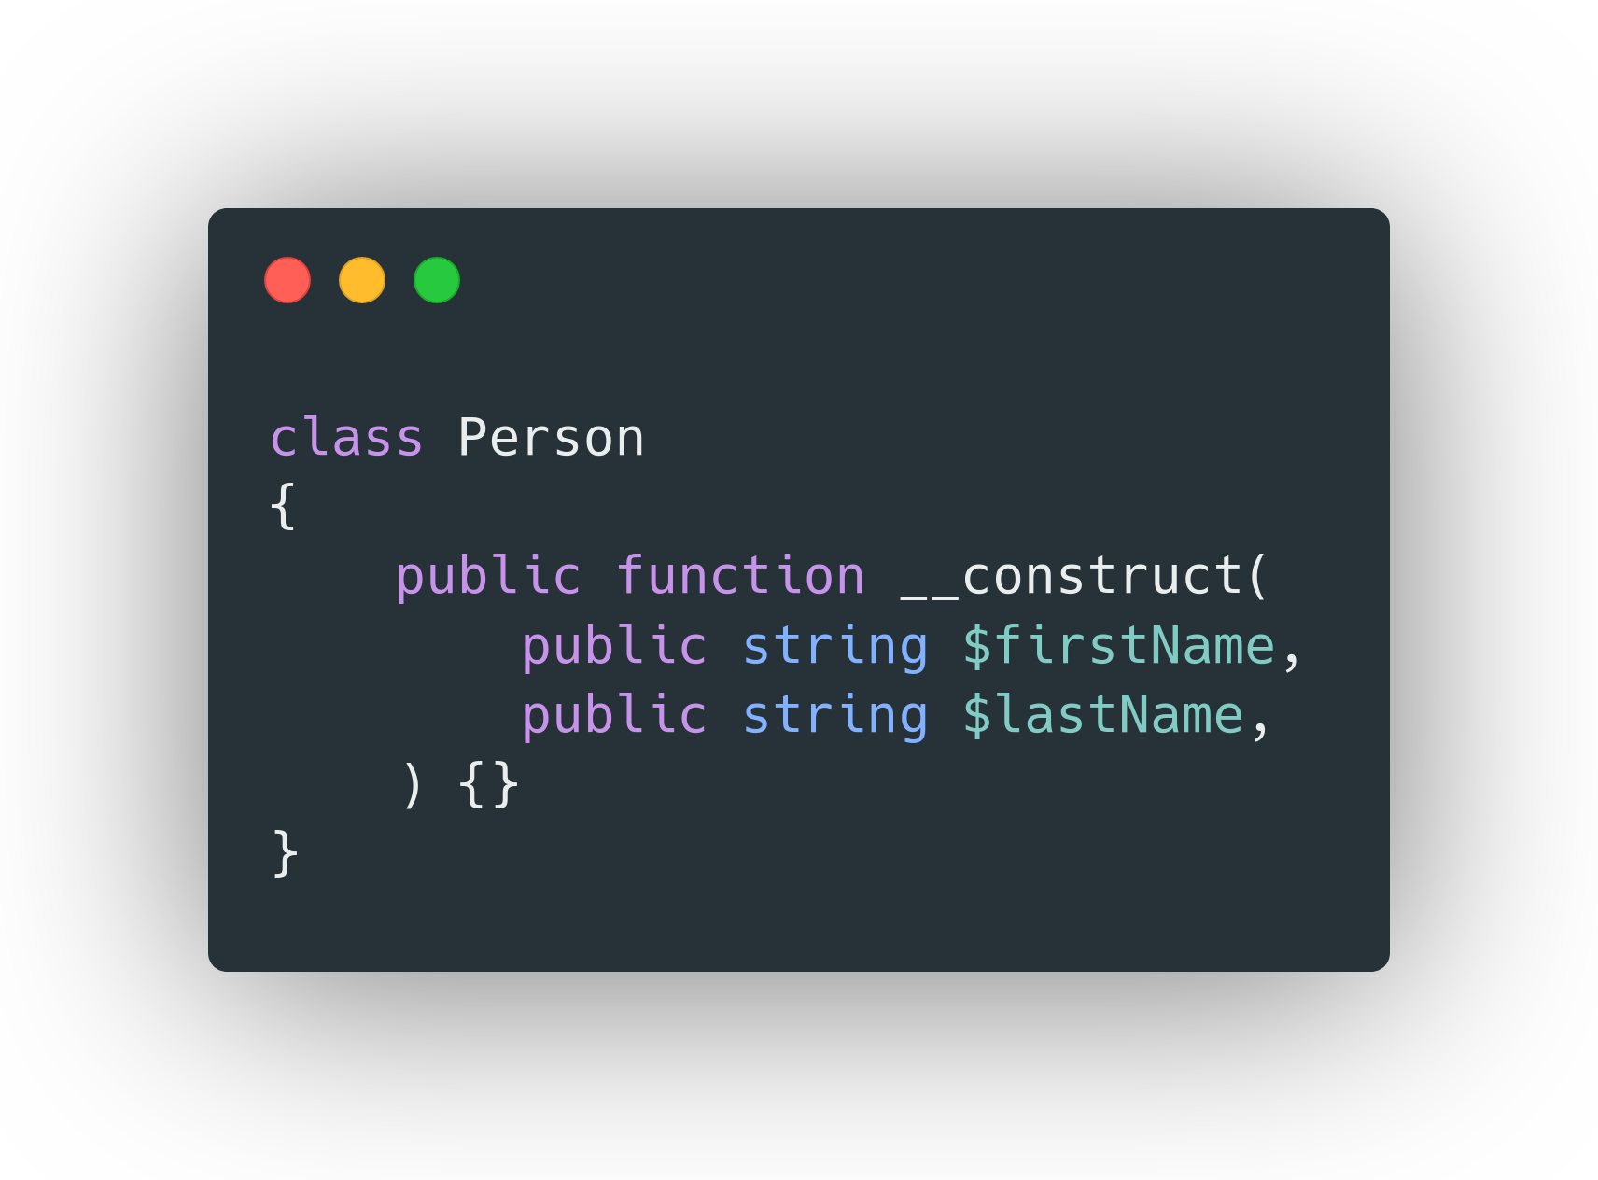
Constructor property promotion
https://wiki.php.net/rfc/constructor_promotion

Slide 29
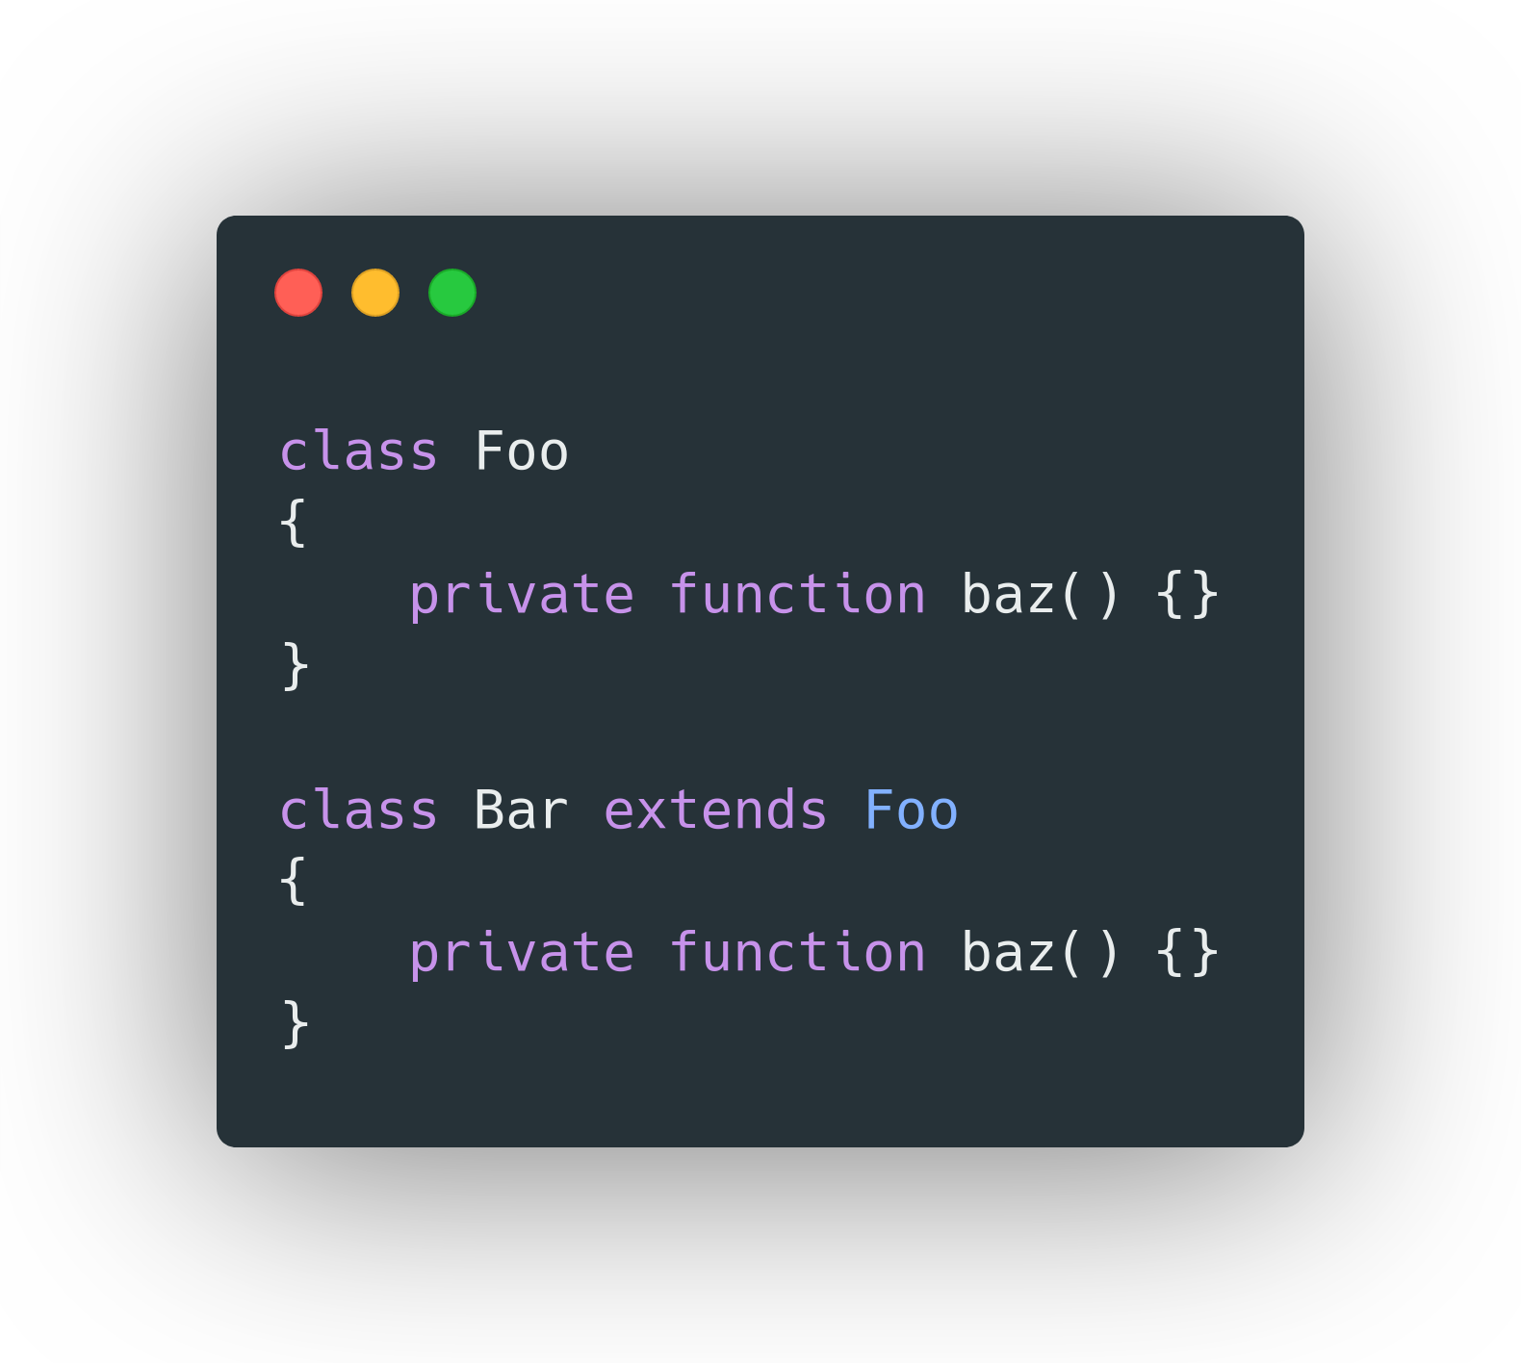
Inheritance with private methods
https://wiki.php.net/rfc/inheritance_private_methods

Slide 30
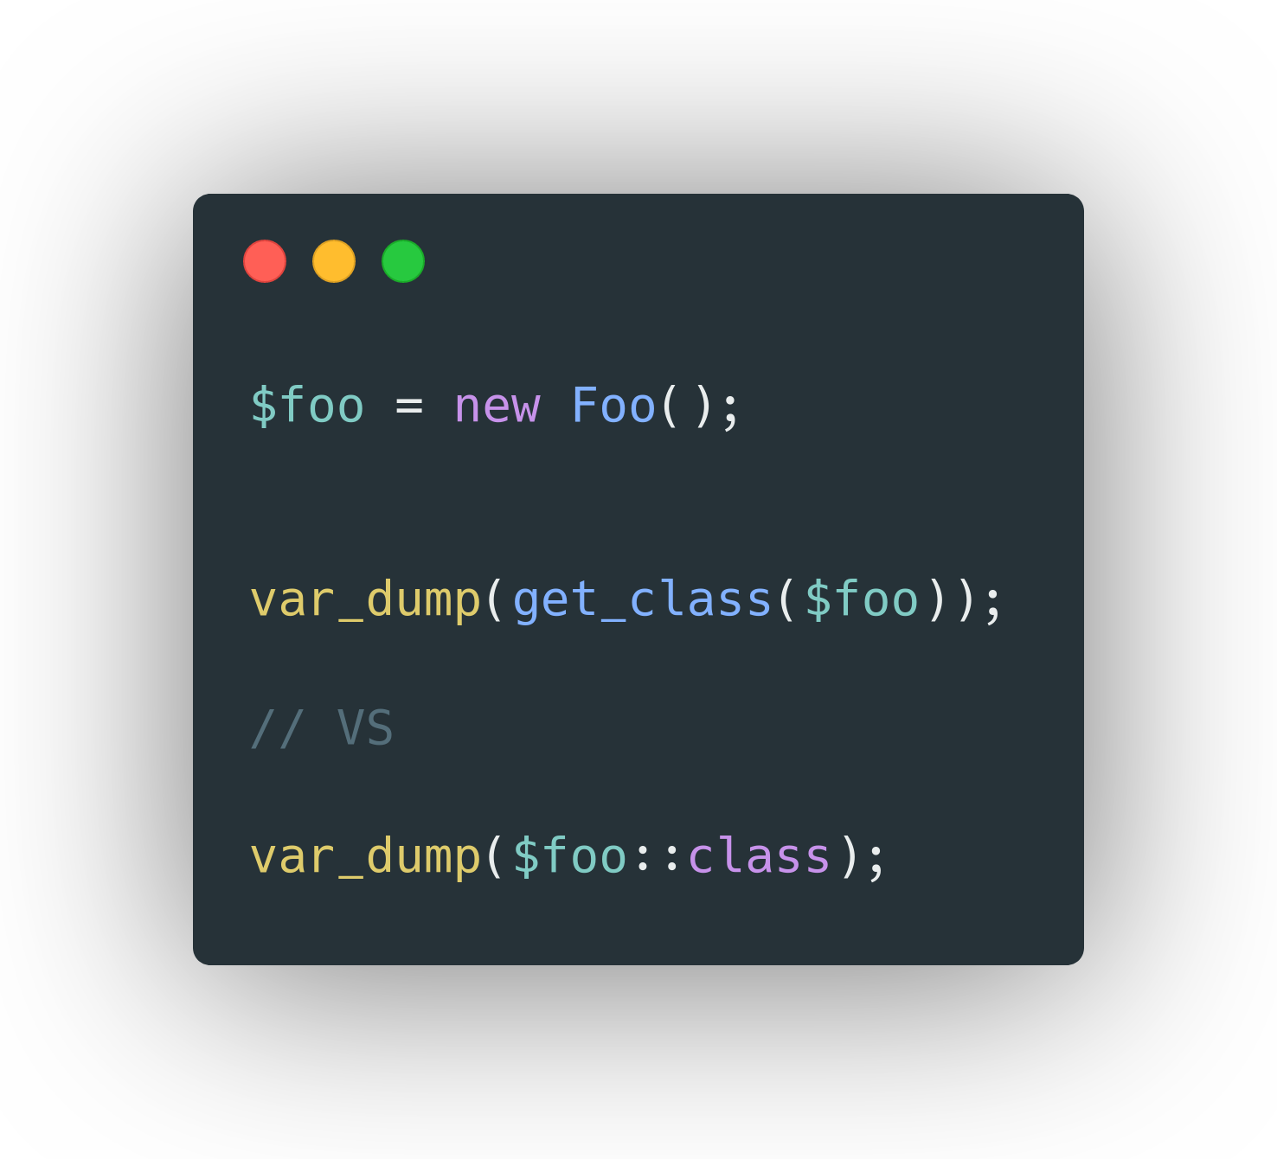
Allowing ::class on objects
https://wiki.php.net/rfc/class_name_literal_on_object

Slide 31
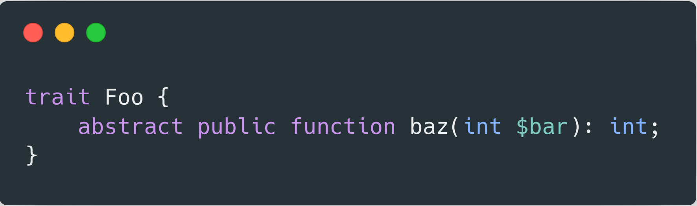
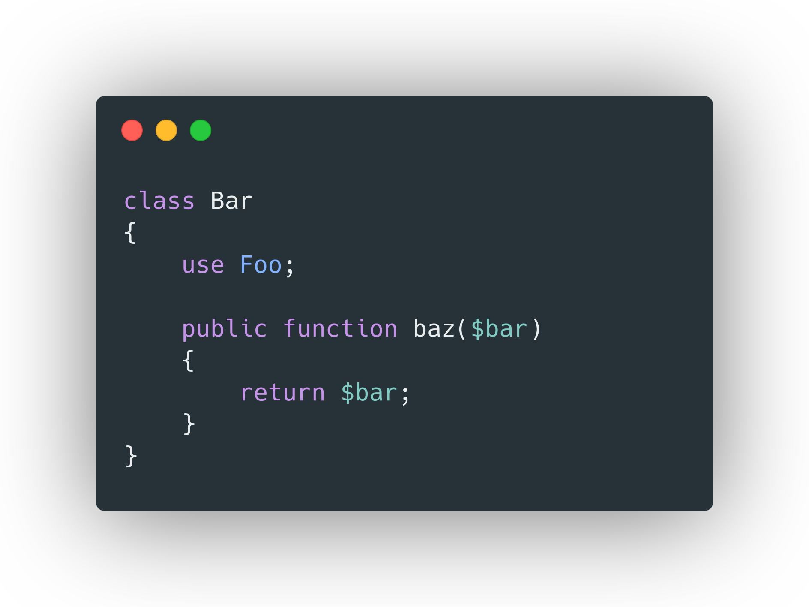
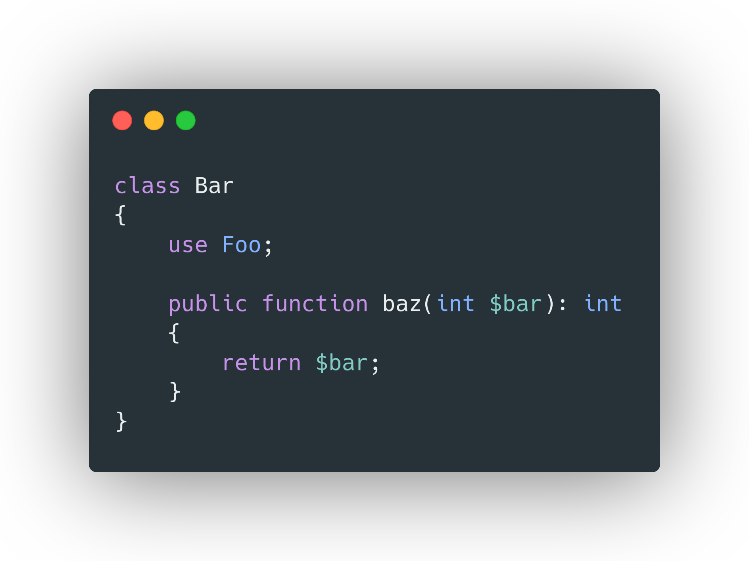
Abstract trait method validation
https://wiki.php.net/rfc/abstract_trait_method_validation

Slide 32
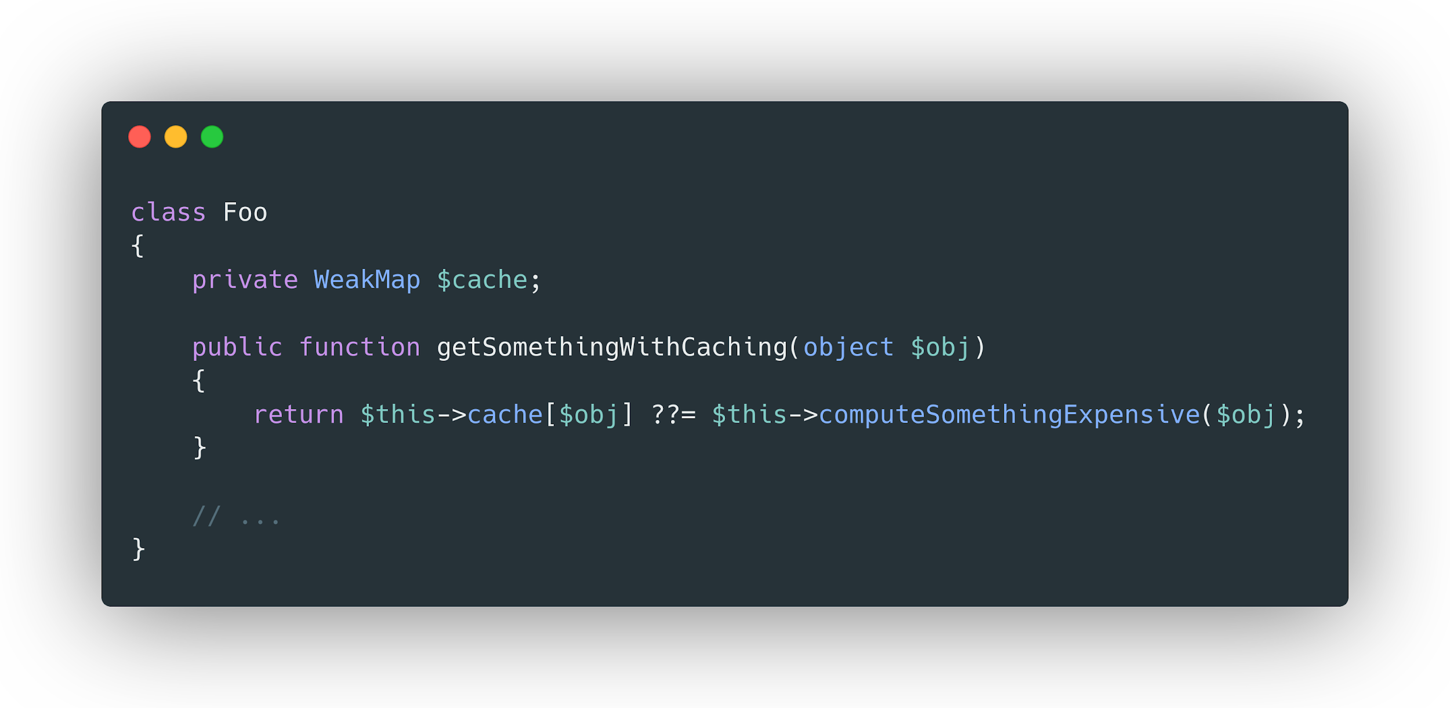
Weak maps
https://wiki.php.net/rfc/weak_maps

Slide 33
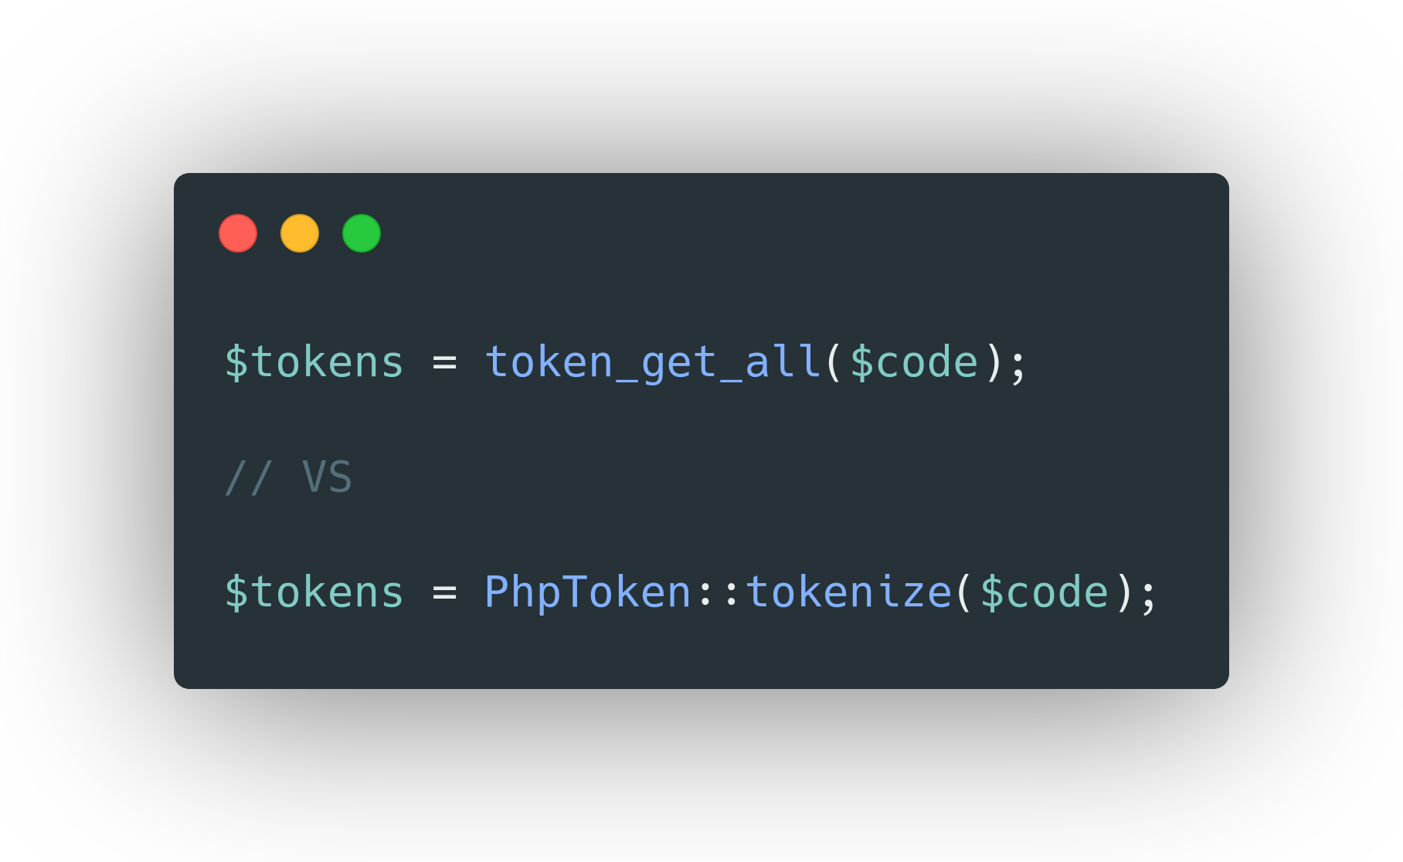
Token as object
https://wiki.php.net/rfc/token_as_object

Slide 34
New internal (built-in) functions

Slide 35
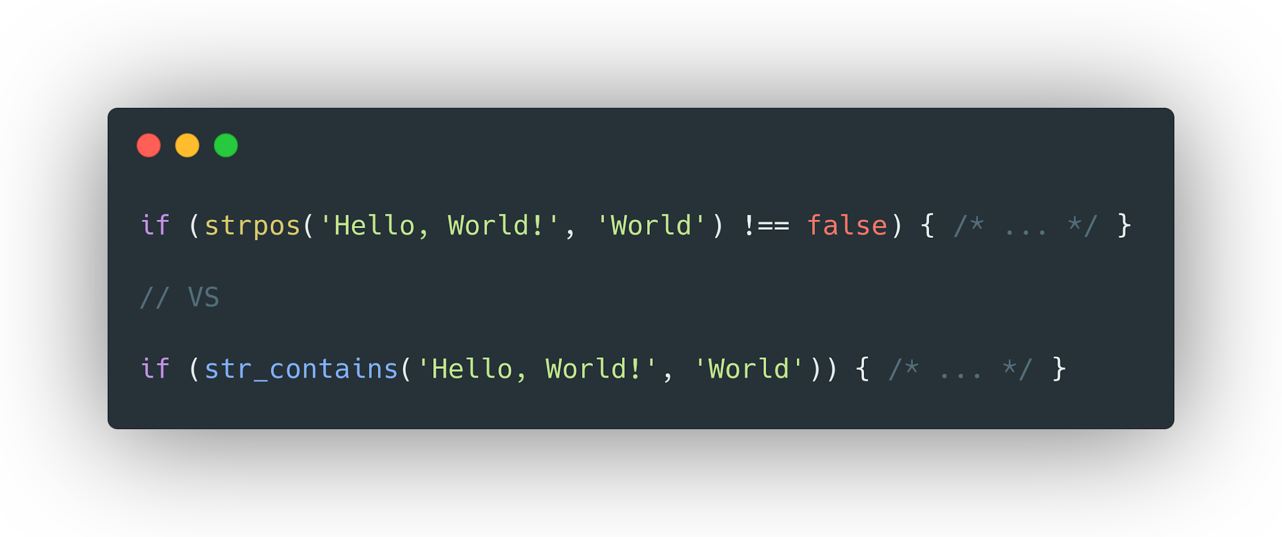
str_contains()
https://wiki.php.net/rfc/str_contains

Slide 36
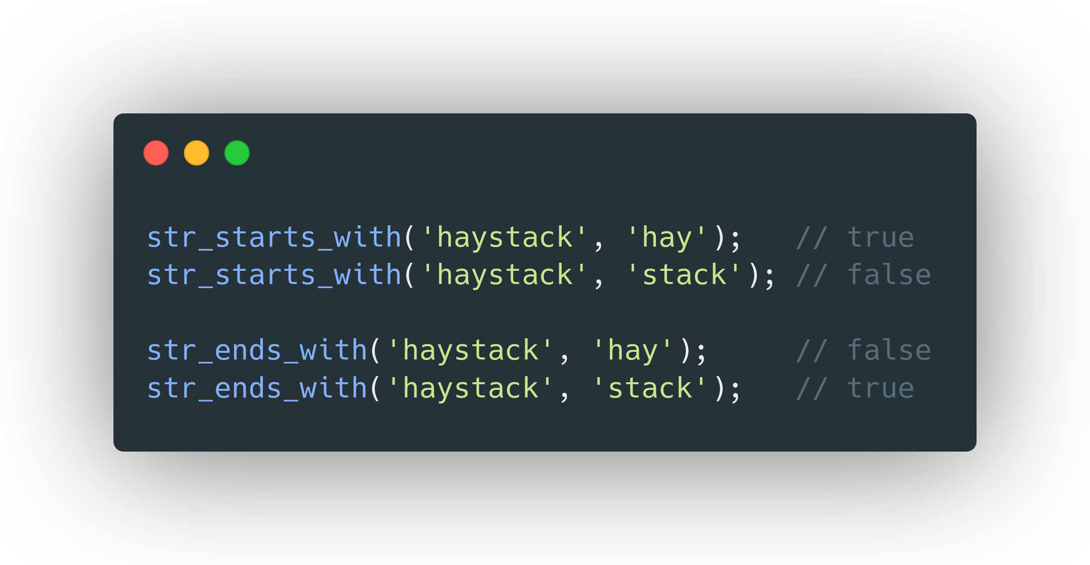
str_starts_with() & str_ends_with()
https://wiki.php.net/rfc/add_str_starts_with_and_ends_with_functions

Slide 37
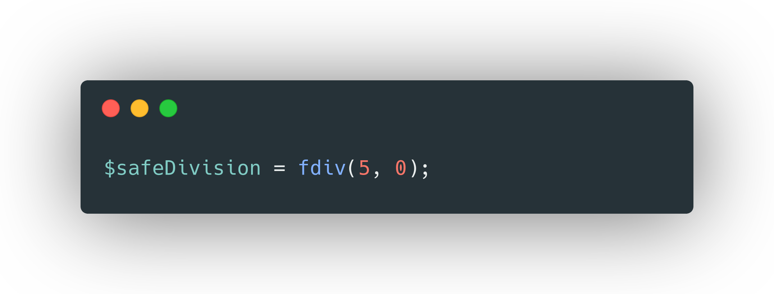
fdiv()

Slide 38
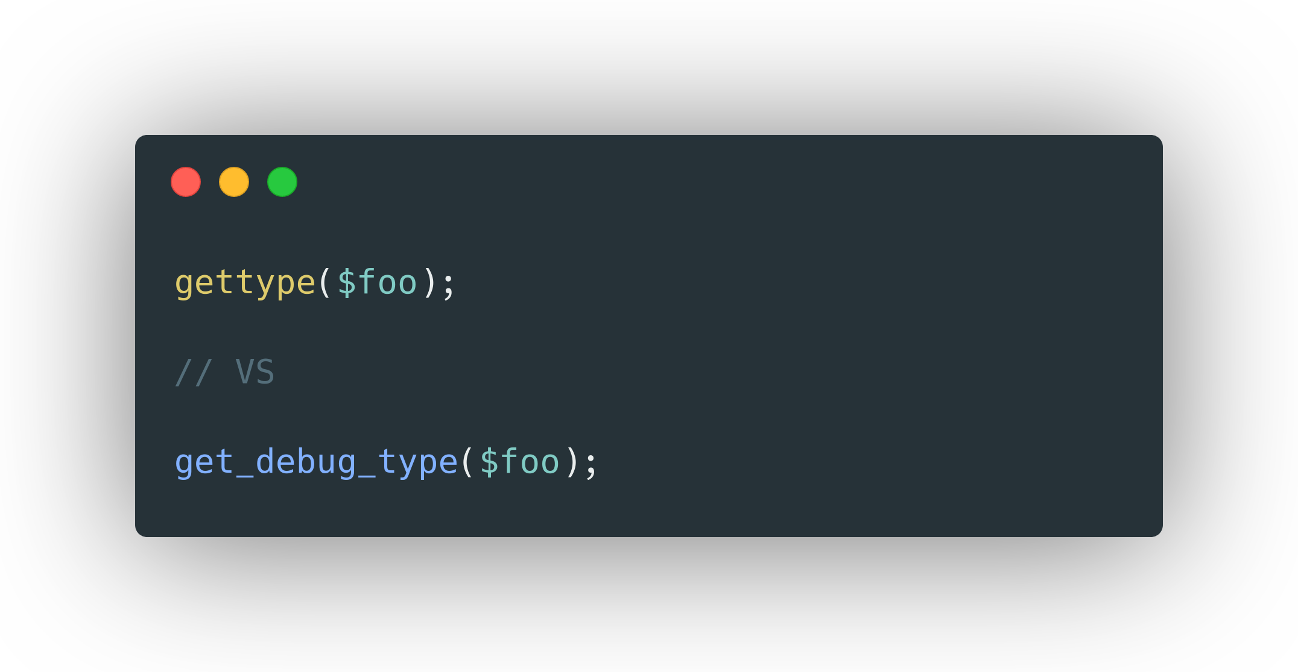
get_debug_type()
https://wiki.php.net/rfc/get_debug_type

Slide 39
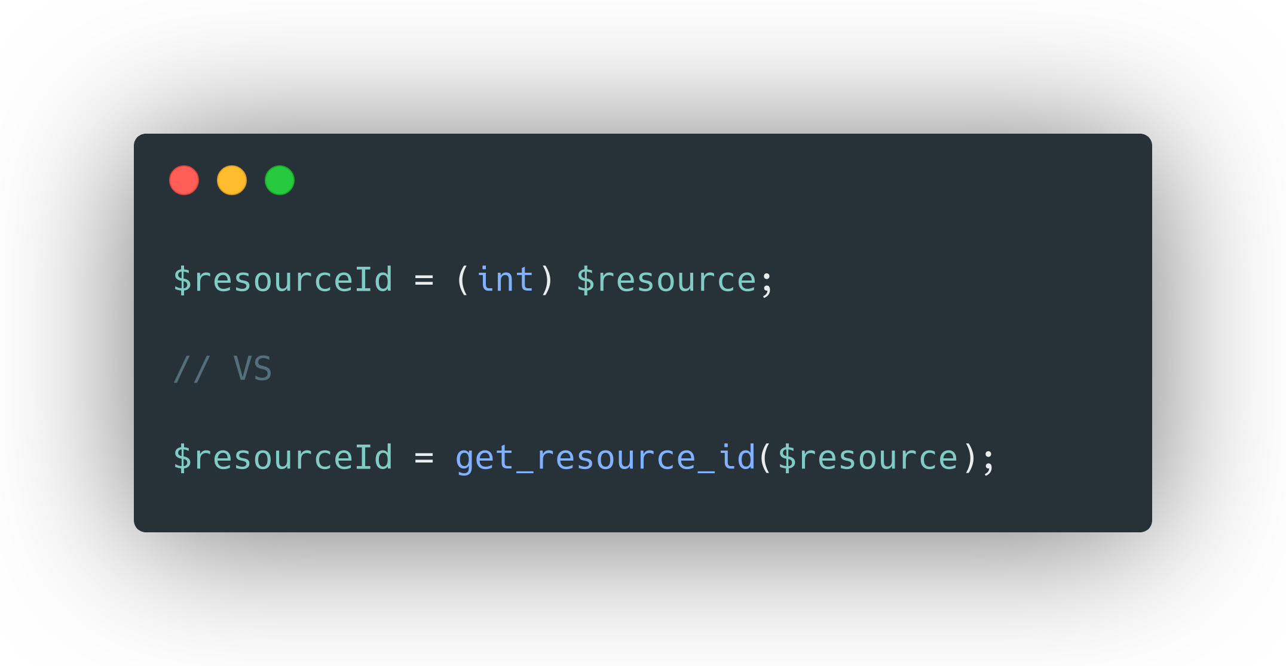
get_resource_id()

Slide 40
Breaking changes

Slide 41
Breaking changes
Methods with the same name as the class are no longer interpreted as constructors.
Removed ability to call non-static methods statically.
Removed each(). foreach or ArrayIterator should be used instead.
Removed ability to use array_key_exists() with objects. Use one of isset() or property_exists() instead.
https://github.com/php/php-src/blob/PHP-8.0/UPGRADING#L20

Slide 42
Reclassified engine warnings
https://wiki.php.net/rfc/engine_warnings
Undefined variable: Error exception instead of notice;
Undefined array index: warning instead of notice;
Division by zero: DivisionByZeroError exception instead of warning;
Undefined property: %s::$%s: warning instead of notice;
Array to string conversion: warning instead of notice;
The default error reporting level is now E_ALL. This means that many errors might pop up which were previously silently ignored.

Slide 43
Questions ?

Slide 44
